Slide 1
Company Name & Logo On This Page Serving (Territory) Since (Year)

Slide 2
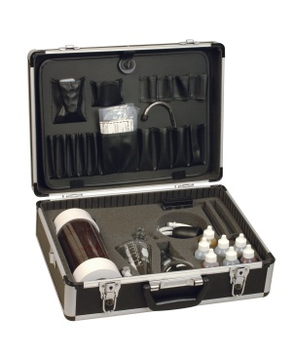
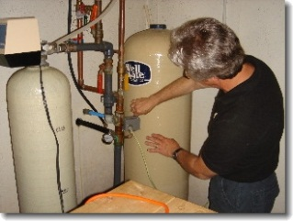
What We Will Be Doing…
Plumbing Assessment
Water Analysis
Recommend Solutions
Ask Questions

Slide 3
Nature…The First Water Treatment

Slide 4
Water That Goes…

Slide 5
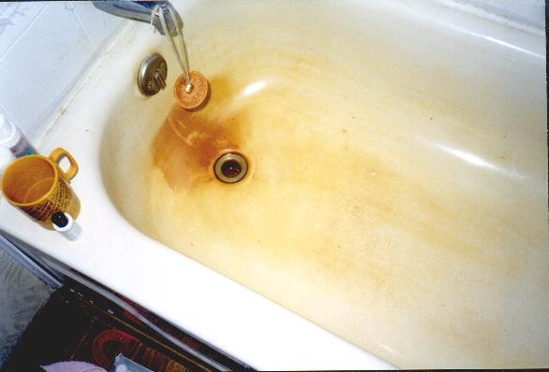
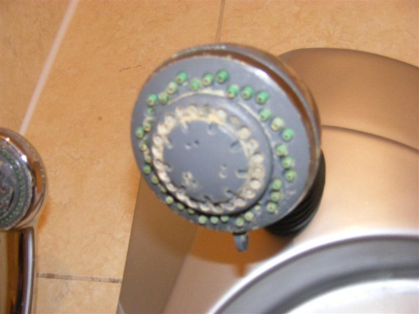
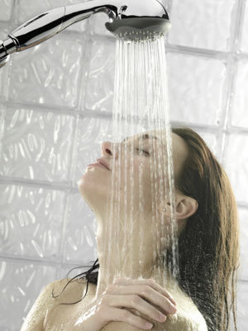
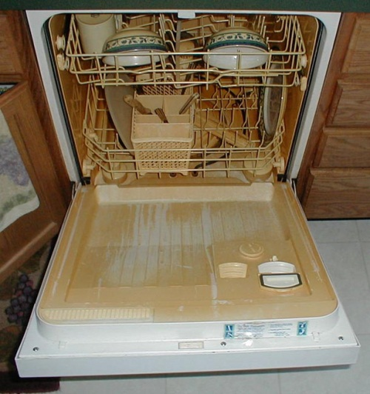
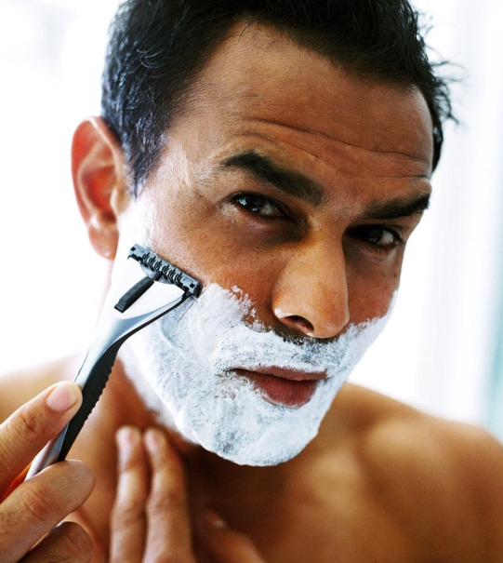
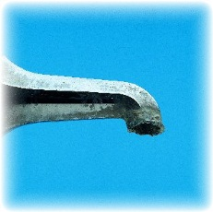
On You…

Slide 6
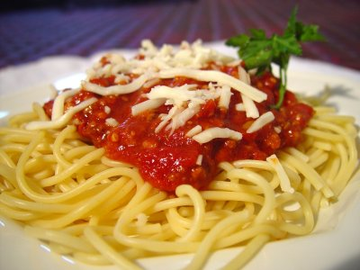
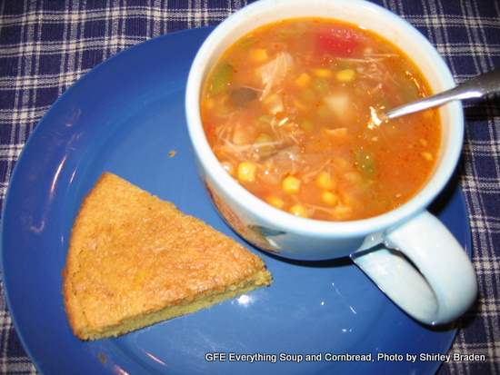
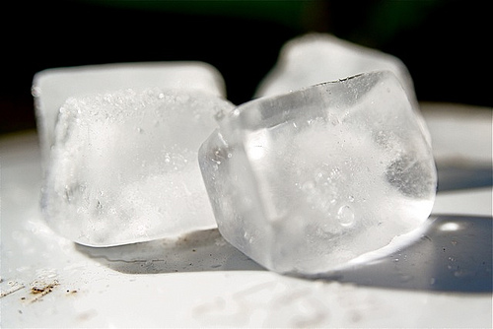
…and In You
Which is a Higher Priority for You?

Slide 7
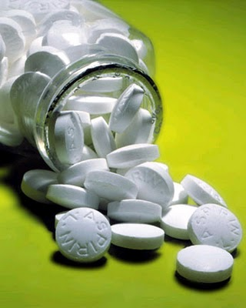
How Hard is Your Water
Hard Water is found in 85% of all American Homes
US Geological Survey
A family of four with water hardness of just 5 gpg will have over 75 lbs of dissolved rock flow though their plumbing system and appliances.
(7000 grains equals 1 pound)

Slide 8
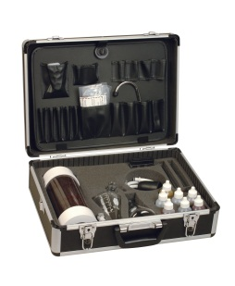
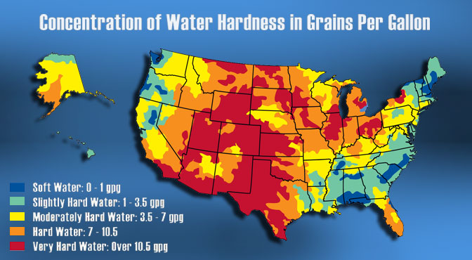
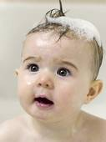
WQA Hardness Scale

Slide 9
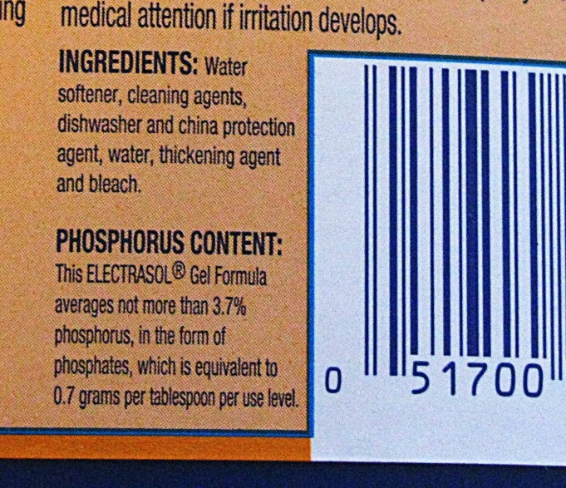
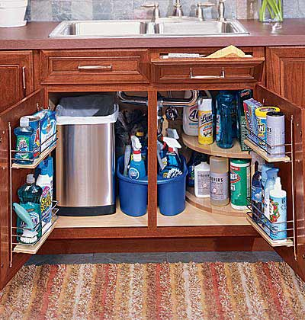
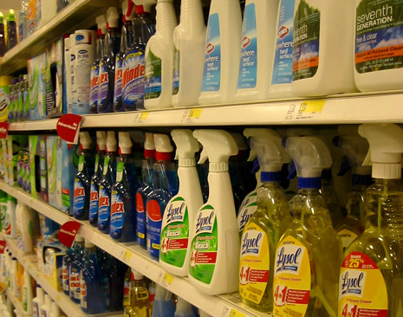
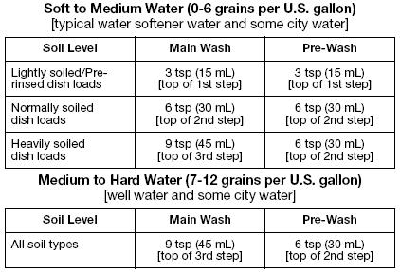
How Much are you Paying to Chemically Treat Your Water?

Slide 10
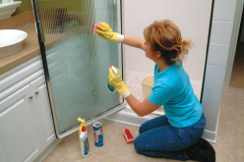
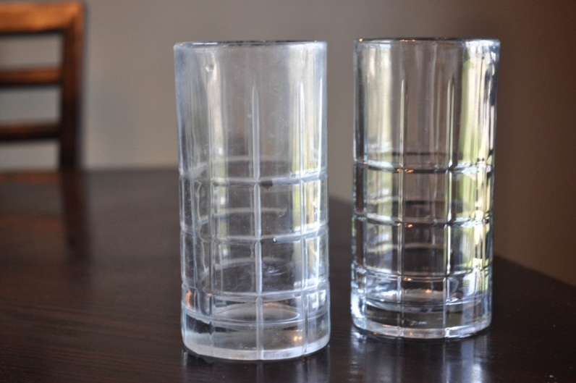
How Much… …is Your Time Worth? …to Replace Your Fixtures & Dishes?

Slide 11
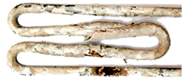
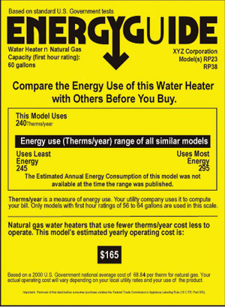
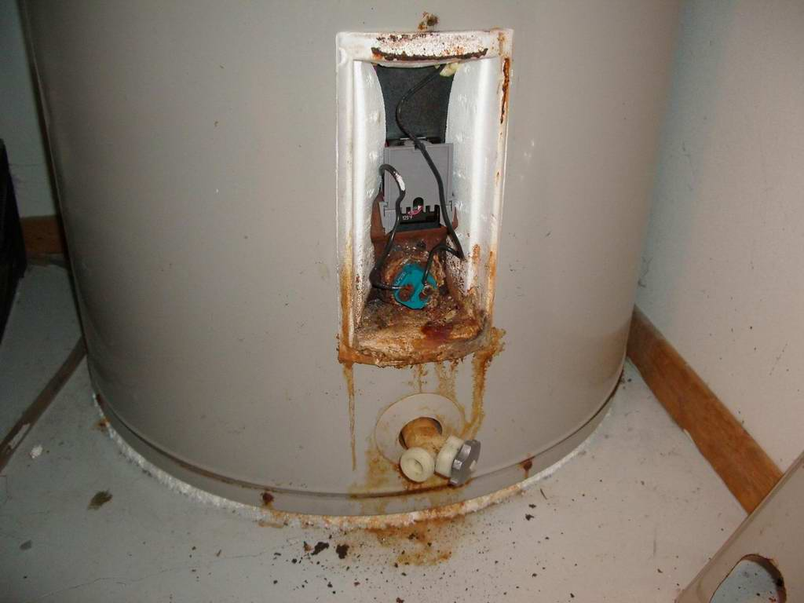
How Much… …to Replace Your Appliances? …Water Heater?
“Between 22% & 29% more energy is consumed by water heaters operated on hard water.”
Water Quality Research Council
New Mexico State University
from a WQA research report

Slide 12
Water is You

Slide 13
GO GREEN
Americans use approximately 70 million plastic water bottles each day, with 60 million of these bottles being sent to landfills.
Container Recycling Institute: Down the Drain

Slide 14
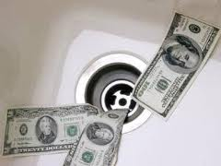
How Much Are You Spending?
1 case bottled water per week=
$6.00 24 bottles per week
$24.00 96 bottles per month
$288.00 1152 bottles per year
$1440.00 5760 bottles per 5 year

Slide 15
What Does Your Dog Know That You Don’t?

Slide 16
Softener Types

Slide 17
How it Works

Slide 18
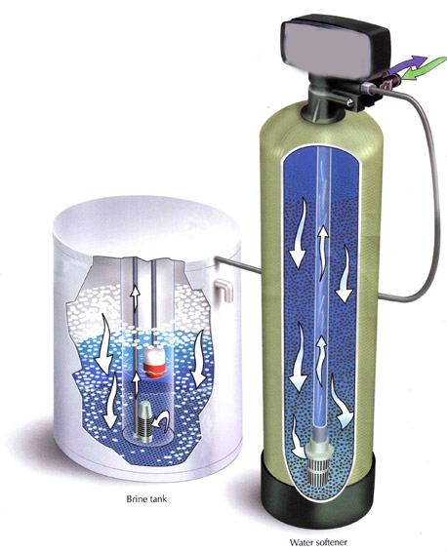
How it Works

Slide 19
Self Contained
Pros:
Less Expensive
Good if limited on space
Cons:
Difficult to clean
Short Warranty
Often Undersized

Slide 20
Single Tank Timer

Slide 21
Single Tank Meter

Slide 22
Twin Tank Demand

Slide 23
Reverse Osmosis
Insert Clip Art Image of Your Company’s RO on this page

Slide 25
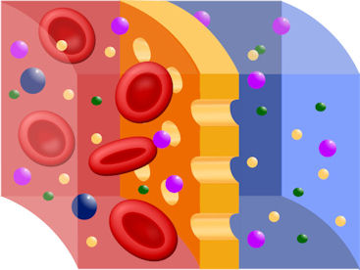
The RO Process

Slide 26
The RO Membrane

Slide 27
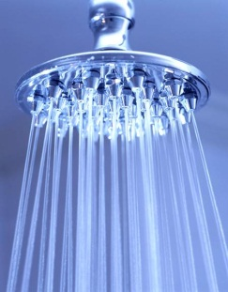
Which Makes the Most Sense?
Insert Clip Art For Your Company Products

Slide 28
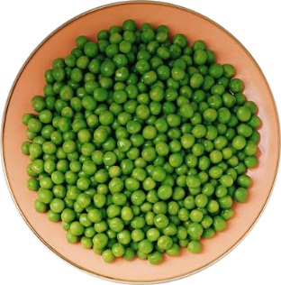
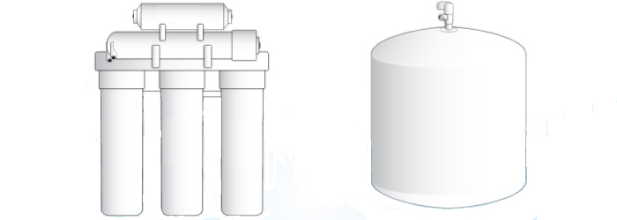
Which Makes the Most Sense?
Insert Clip Art For Your Company Products

Slide 29
Thank You for the
Opportunity to Serve You

